Slide 1
Project 1: S&P 500 Analysis

Slide 2
Agenda
Purpose of the Project
Resources & Software
Data Manipulation and Calculations
Data Visualizations
Final Implications

Slide 3
Purpose
Analyzed the annual performance of S&P 500, their sectors and the largest company per sector over a fixed span of time and found correlation with three market indicators.
Market indicators are :
CBOE Volatility Index (VIX)
Price of Gold (oz.)
10 Year Treasury Rate Change

Slide 4
Resources & Software
Yahoo Finance
Price information for S&P 500 Index
Price information for 9 of the 11 sectors within the S&P 500 Index
Price information of 9 top performing companies within each sector
Real Estate & Communications Sector created after 1999
Software
Python Jupyter Notebook
Pandas
Matplotlib
Notes:
9 of 11 RE and Communications came out post 1990

Slide 5
Data Manipulation and Calculations
Import CSV files
Left merge based on date (month)
Filtered data based on date using Datetime function
Percent Change Year-Over-Year calculation
Plotting and visualizing

Slide 6
Data Visualizations for S&P 500
Annual performance 1990 -2020
Market indicators
Industry performance
Individual top performing companies

Slide 7
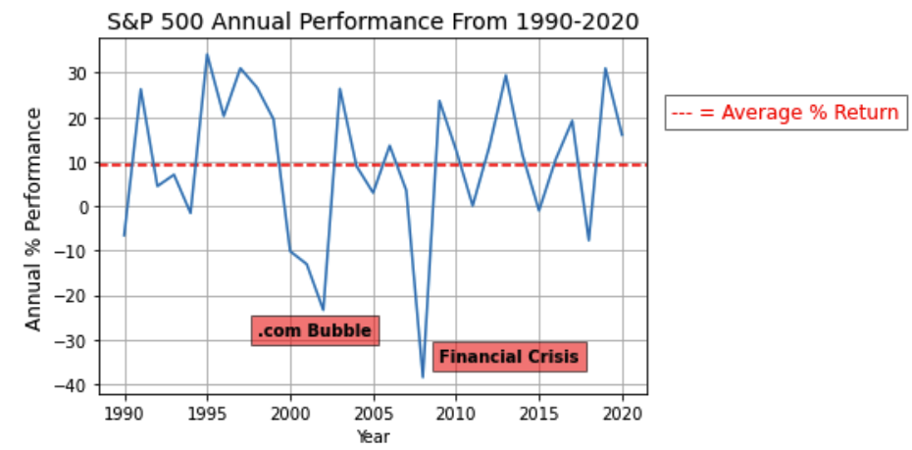
S&P 500 Annual Performance (1990-2020)
Two major dops
Dot.com bubble & Financial Crisis 2008
Roughly a 10% average return per year over this time period

Slide 8
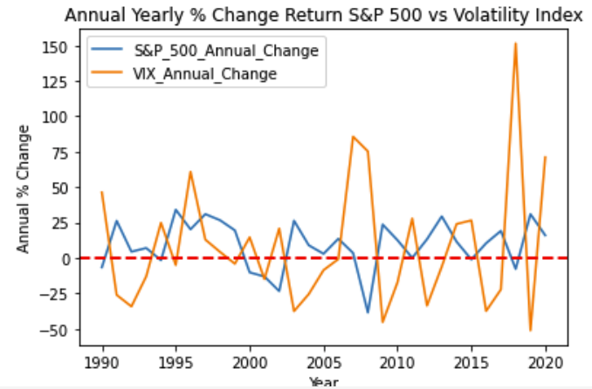
S&P 500 vs. CBOE Volatility Index (VIX)
The level volatility did not have a direct correlation to the performance of the S&P 500
R-Value: 0.2157
Notes:
VIX as an indicator of insecurity in the market. Usually during elections which the VIX increases.

Slide 9
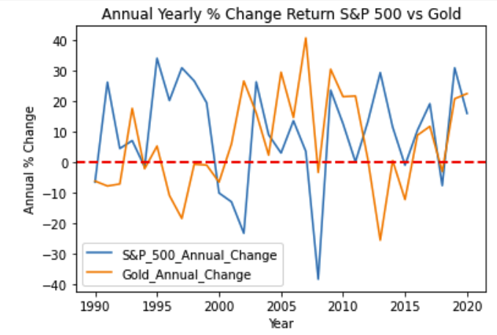
S&P 500 vs. Price of Gold (oz.)
The value of gold did not have a direct correlation to the performance of the S&P 500
R-Value: 0.004
Average rate of return for gold during this time period was 6.2% (comparatively to ~10% for S&P 500)
Notes:
Average rate of return for gold during this time period was 6.2% while the S&P is 9.36%
Gold dropped during 1997 & 2013.
S&P fell in 2003 and 2008

Slide 10
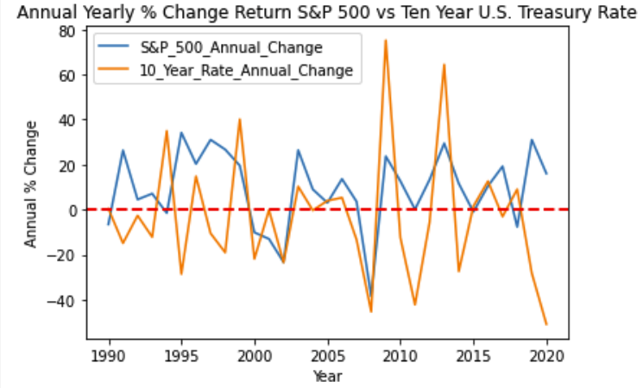
S&P 500 vs. 10 Year Treasury Rate Change
The 10 Year Treasury Rate did not have a direct correlation to the performance of the S&P 500
R-Value: 0.07
10 year treasury are reactive to how the economy is going. Therefore, they are very “related”.
Notes:
10 year treasury are reactive to how the economy is going. Therefore, they are very “related”.

Slide 11
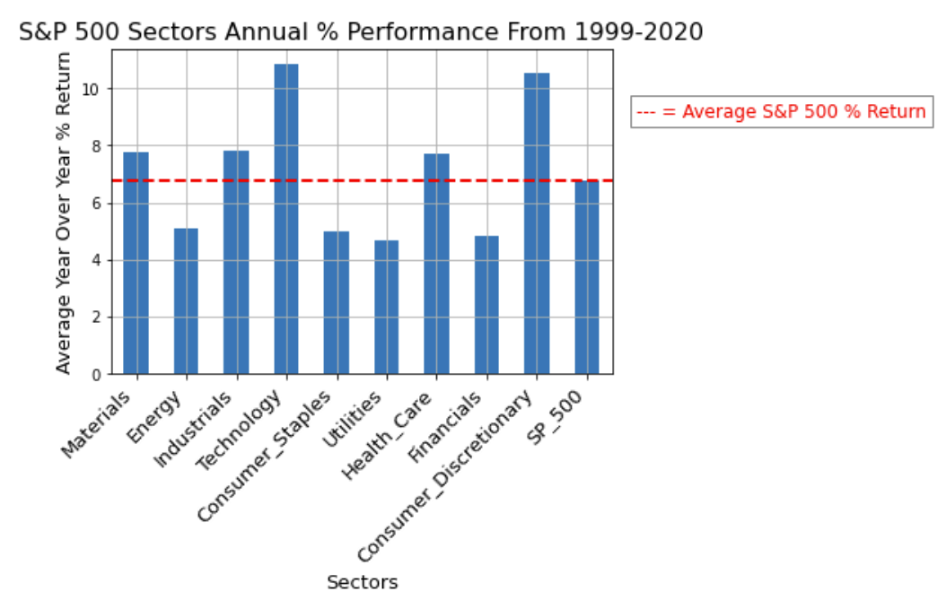
S&P 500 - Sector Performance
5 industries outperformed the S&P 500
S&P return was 6.71%
1999 – 2020
Notes:
Outperforming: Materials, Industrials, Technology, Healthcare, Consumer Discretionary

Slide 12
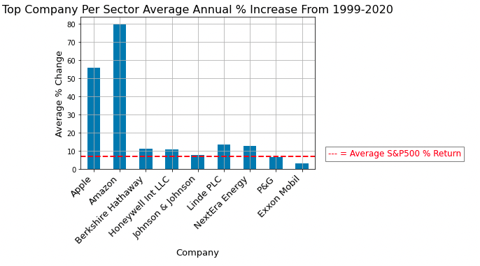
S&P 500 - Largest Companies from each Sector
Analysis of the largest companies per S&P 500 sector
Apple and Amazon two highest performing within their respective sector
Notes:
Most companies outperformed S&P
Exxon and PNG did not.
Apple and Amazon carried their sectors.
Larges companies per ETF that we looked at, not

Slide 13
Implications
With the ~10% return in the S&P 500, if you $100 invested in 1990, you would roughly have $1,700 by 2020
The correlation coefficient for market indicators did not help us because it accounted for only 1990 and 2020
General trend analysis can be interpreted to see market behaviors
Materials, Industrials, Technology, Healthcare, and Consumer Discretionary have outperformed the S&P between 1999-2020
Within the largest companies per sector within the S&P 500, 6 have outperformed the S&P 500 with Apple and Amazon leading performance
Notes:
$100 invested in the S&P 500 would roughly $1700

